Slide 1

Make With SOLIDWORKS!
TTU Library Emerging Tech Workshop
Instructor Sean Scully
2025

Slide 2
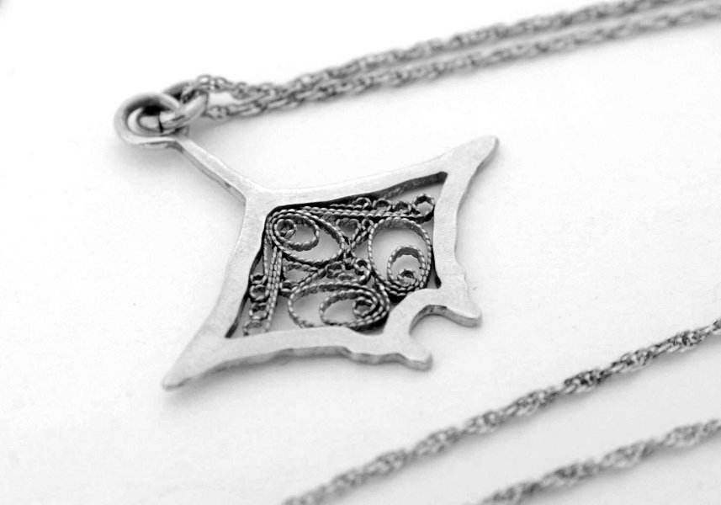
Who am I? Sean W Scully
Lead Administrator – TTU Libraries Makerspace
Rhino3D, TinkerCAD, AutoCAD Inventor, Fusion360, Blender, Solidworks
MakeCode, Python, Scratch, C++, C, MATLAB, Arduino, JavaScript, Assembly, Verilog,
Xilinx
BGS, Math/Engineering/Renewable Energy, TTU
MFA, Studio Art - Metals/Jewelry/Enameling, Kent State Univ
BFA, Studio Art - Metalsmithing/Jewelry Design, TTU
AA, Fine Arts, South Plains College
linkedin.com/in/seanwscully
Find me on the First Friday Art Trail, ffat.org, CASP Work Studio H

Slide 3

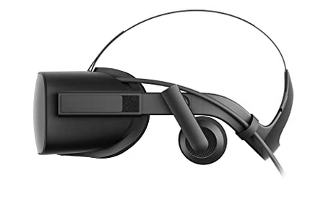
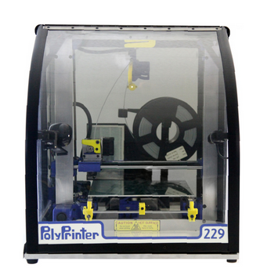
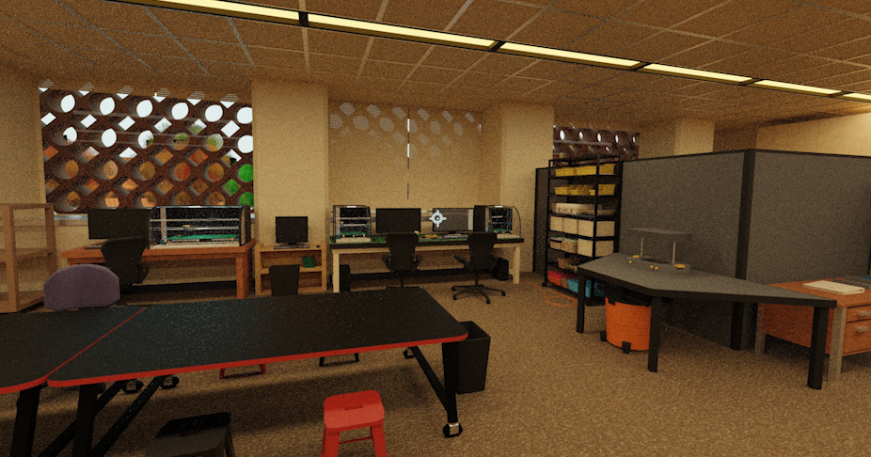
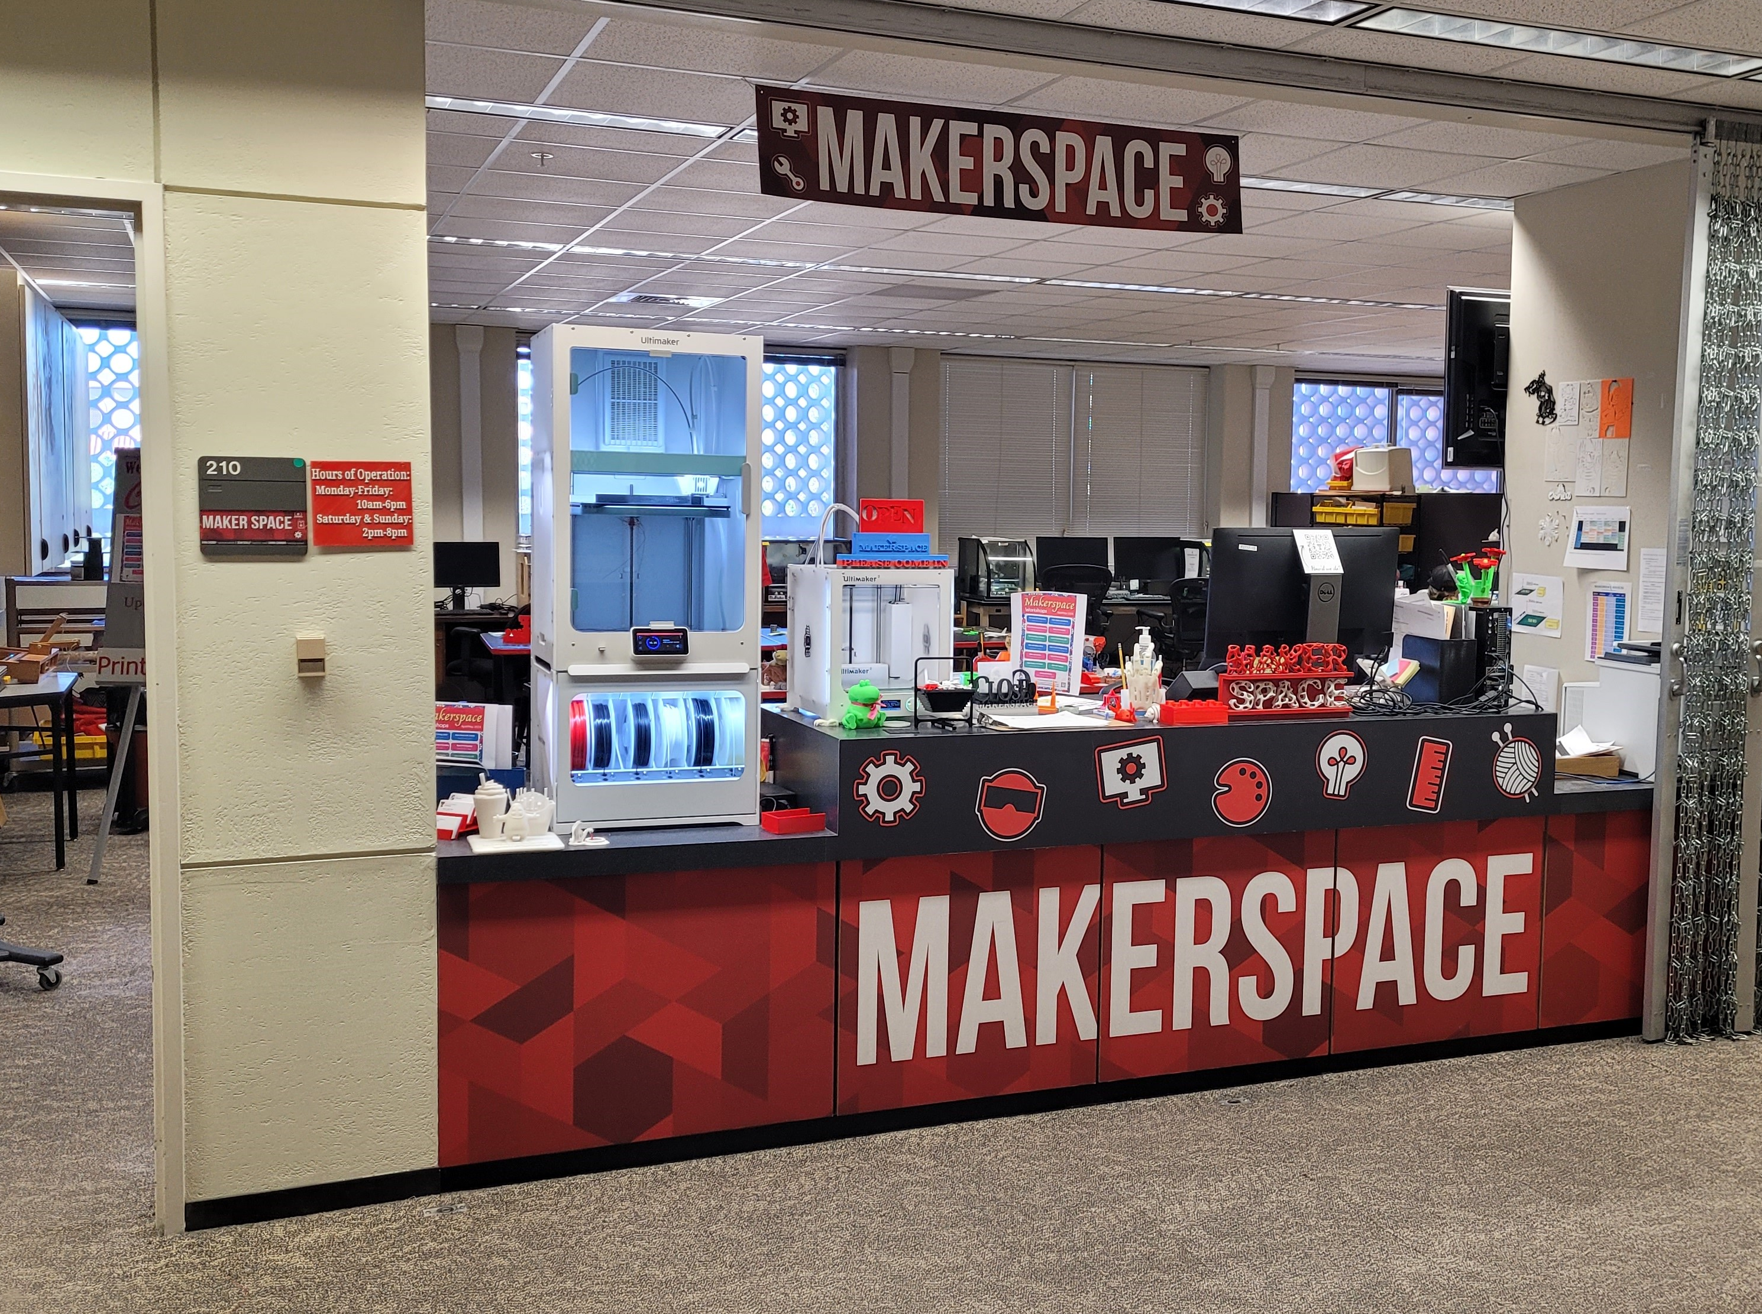
Emerging Technology Dept
Makerspace: Main Library, 2nd floor, room 210
VR Lab: Main Library, 2nd floor, room 201A
make@ttu.edu
https://www.depts.ttu.edu/library/make/
Virtual Walkthroughs - https://www.youtube.com/playlist?list=PLXiD4wAGiKu7iEOkYENiBLHtM9w-dAvFh
Notes:
https://www.amazon.com/Oculus-Rift-Virtual-Reality-Headset-pc/dp/B00VF0IXEY
https://polyprinter.com/printers/
Renderings in Blender by Bella James, 2024

Slide 4
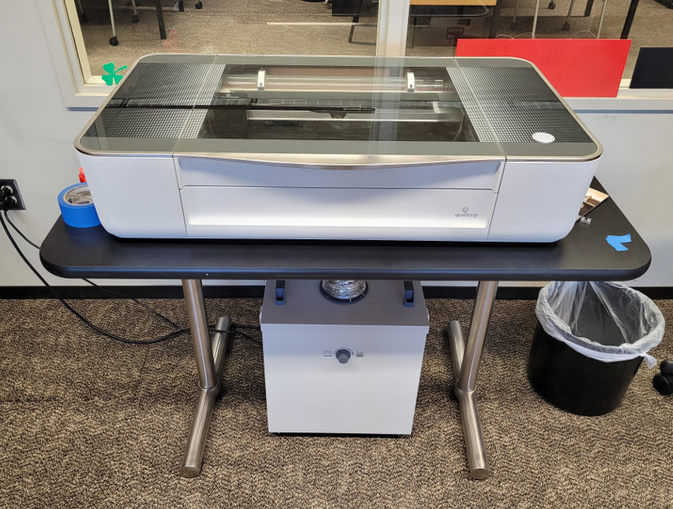
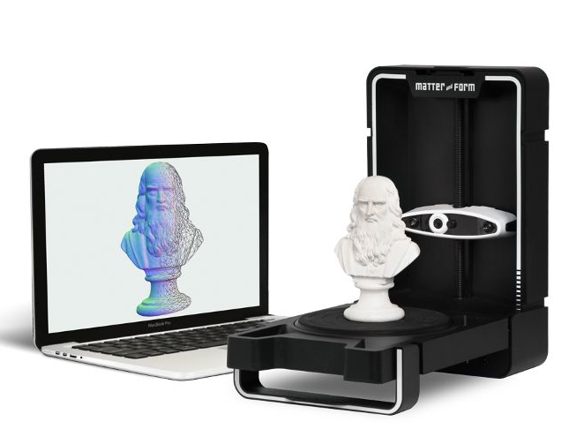
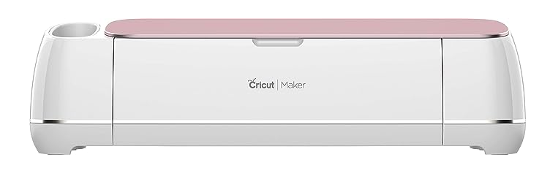
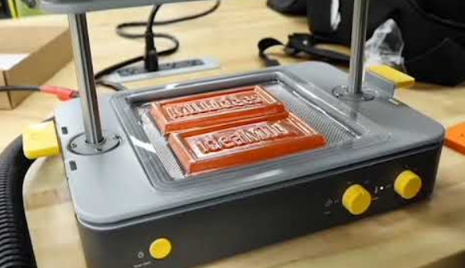
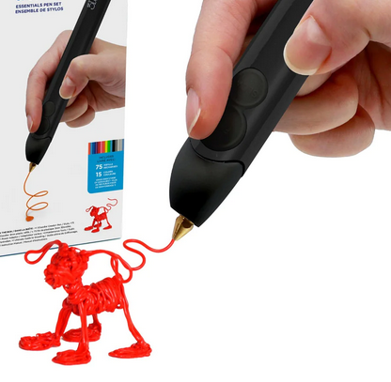
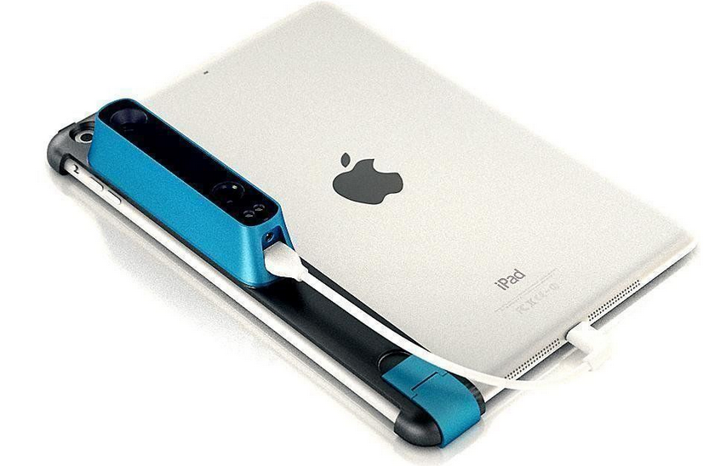
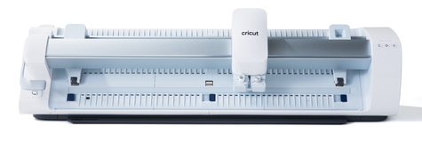
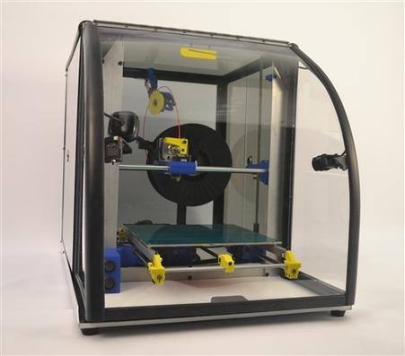
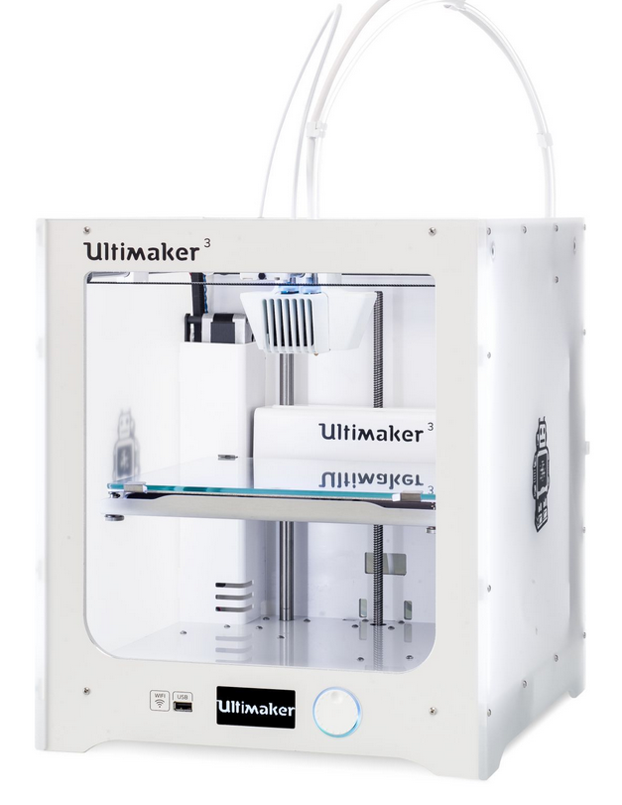
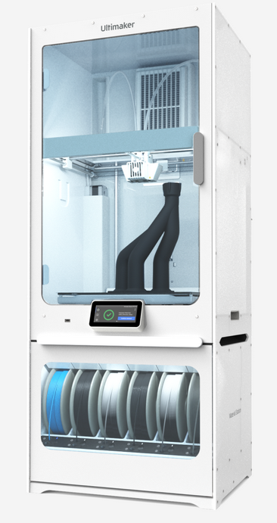
Cricut Maker/Venture
Glowforge Lasercutter
Makyu Formbox
Matter&Form 3D Scanner
PolyPrinters 229 & 508
Ultimaker 3, S7
Sewing machines
Notes:
Introduce Navigating to Makerspace Library website: library.ttu.edu
https://www.depts.ttu.edu/library/make/index.php
https://www.depts.ttu.edu/library/vrlab/index.php
https://ultimaker.com/3d-printers/s-series/ultimaker-s7/
https://www.dynamism.com/matter-and-form/mfs1v2.html
https://www.amazon.com/Cricut-Maker-Electronic-Cutting-Machine/dp/B07GSH7FGX?th=1
https://cricut.com/en-gb/cutting-machines/cricut-venture/2008740.html
https://the3doodler.com/collections/create/products/create-essentials?variant=32419930177620

Slide 5
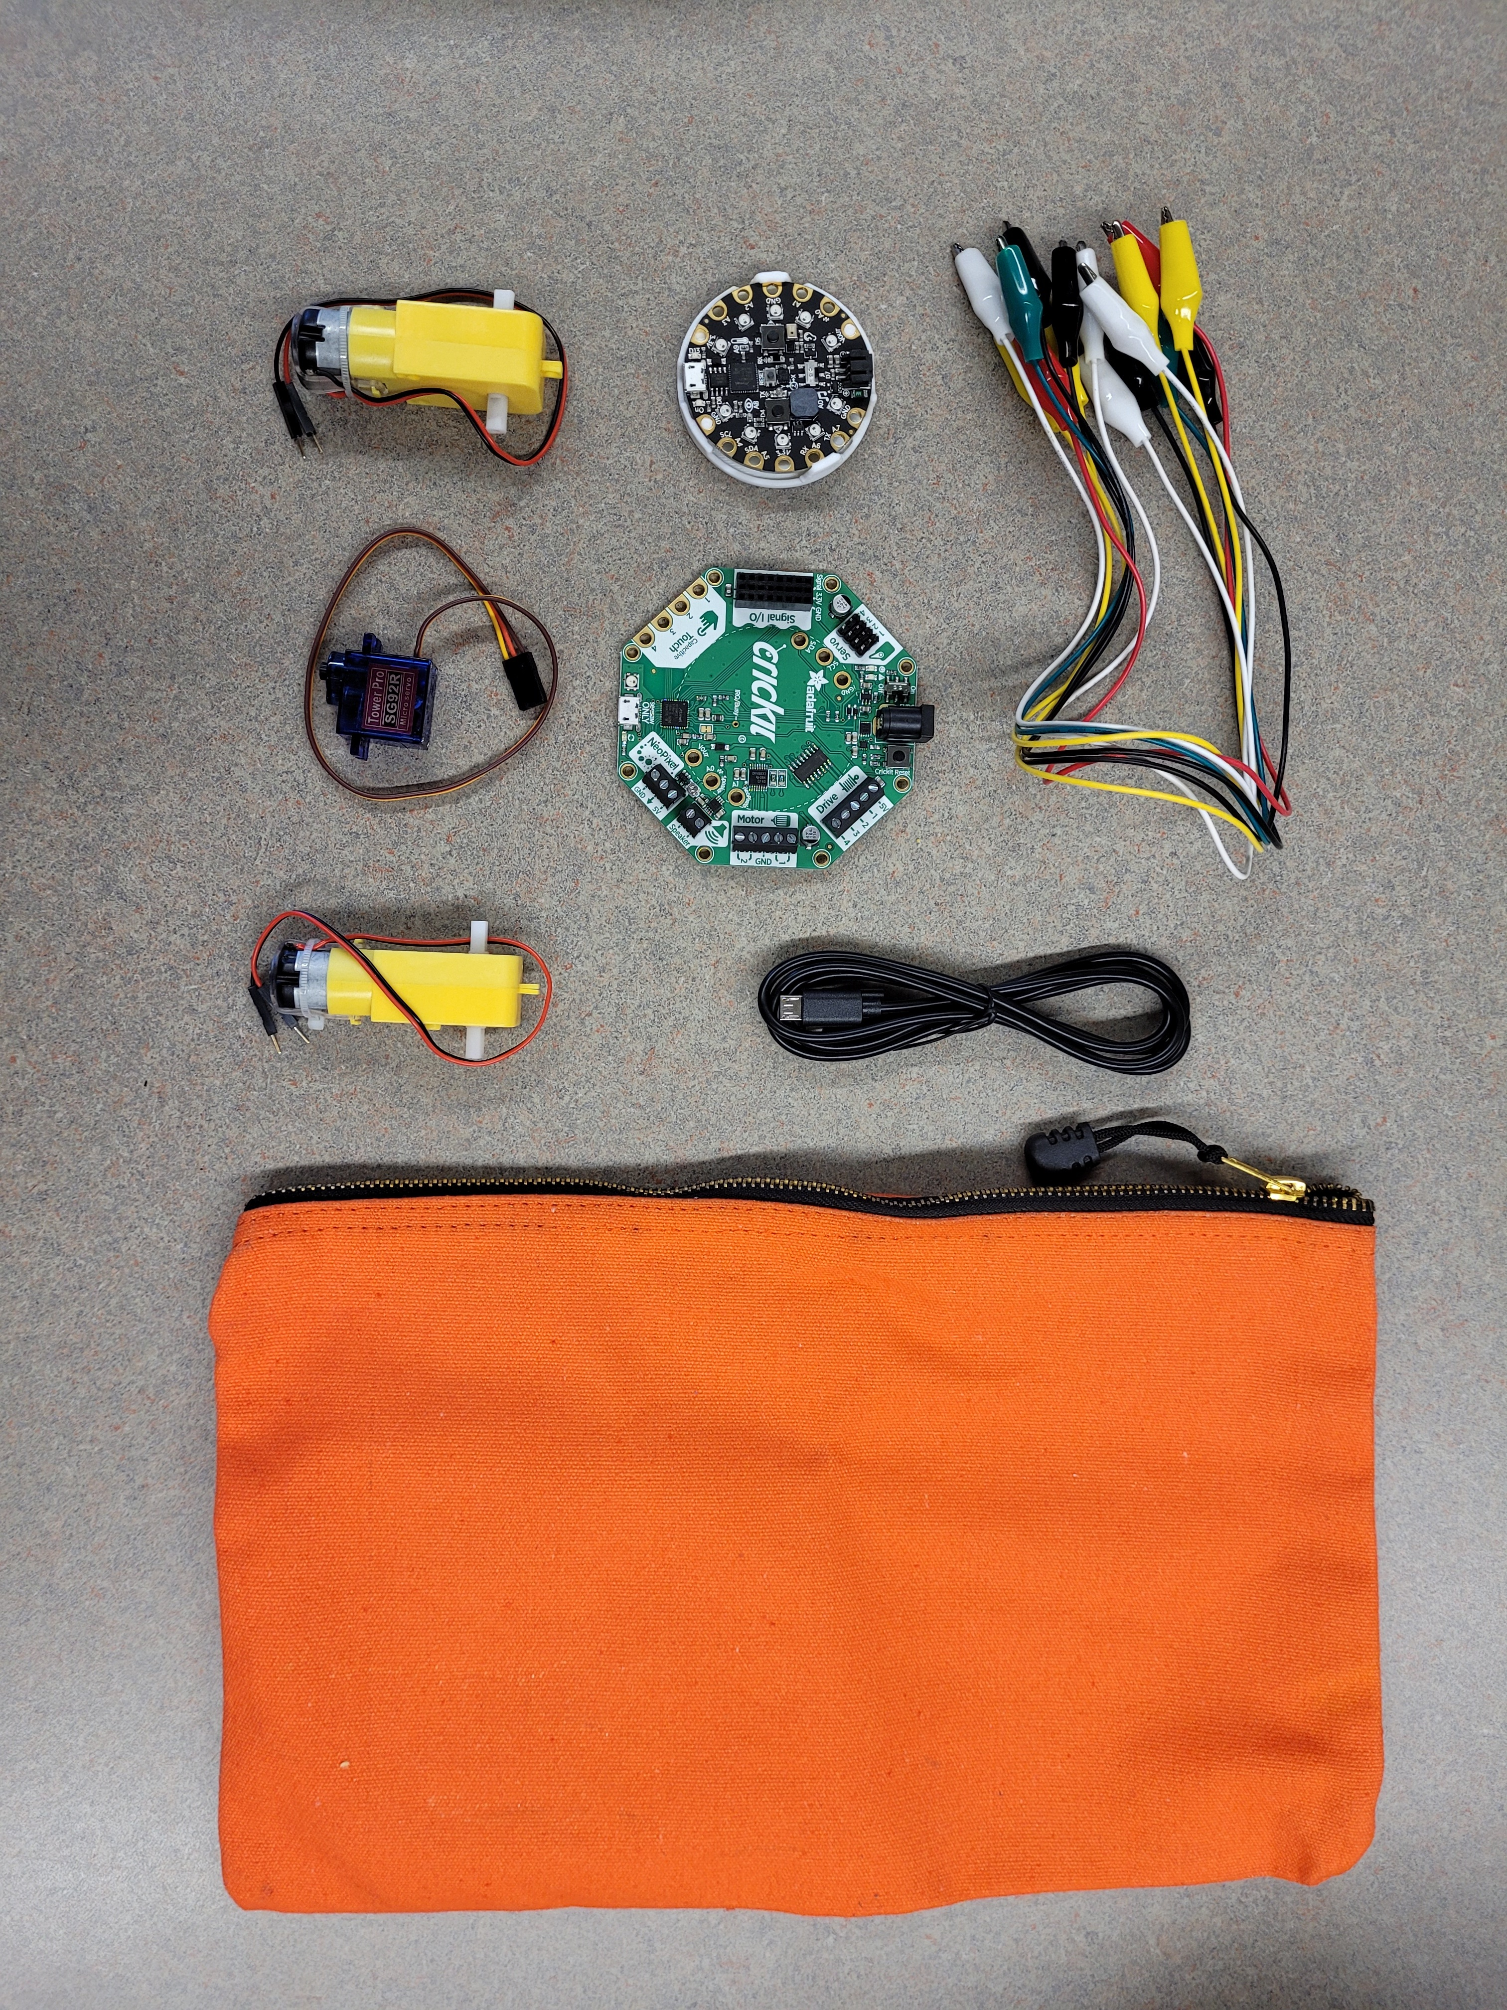
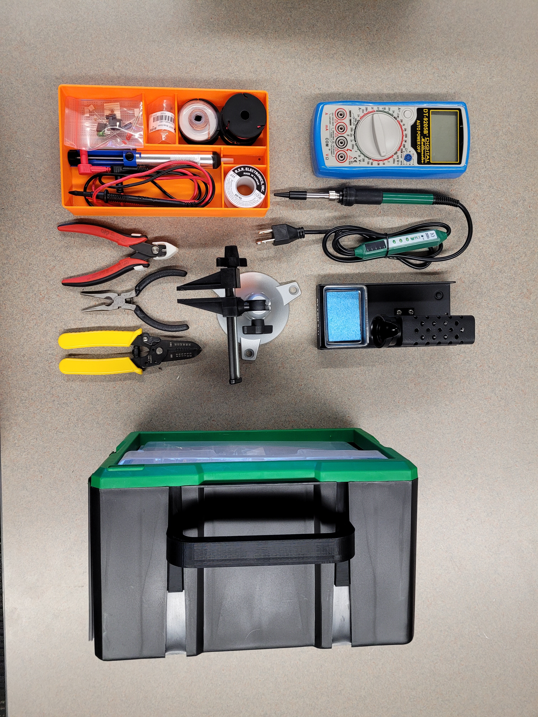
Robo Kits (15)
Adafruit’s Circuit Playground Express (CPX)
Adafruit’s Crickit robotic control board
geared motors (2), micro servo
ElectroSoldering Kits (5)
Notes:
Introduce Navigating to Makerspace Library website: library.ttu.edu
https://www.depts.ttu.edu/library/make/index.php
https://www.depts.ttu.edu/library/vrlab/index.php
Adafruit:
Circuit Playground Express - CPX:
https://learn.adafruit.com/adafruit-circuit-playground-express
Crickit board:
https://learn.adafruit.com/adafruit-crickit-creative-robotic-interactive-construction-kit
Electro Soldering Kit:
https://www.adafruit.com/product/136

Slide 6
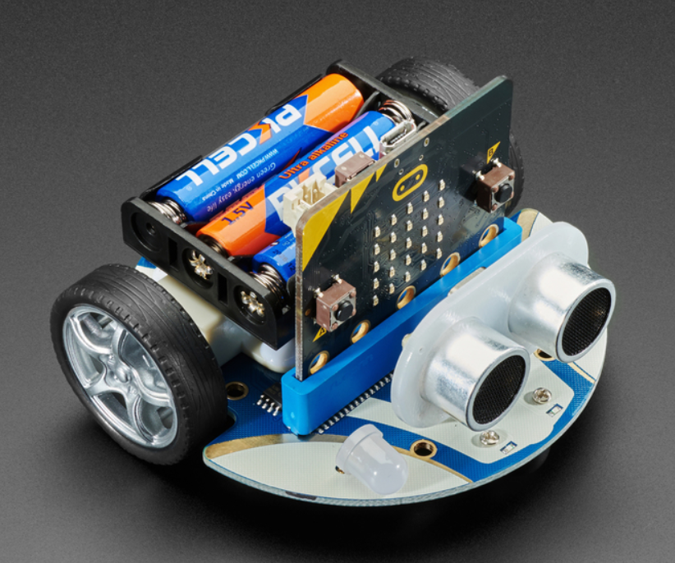
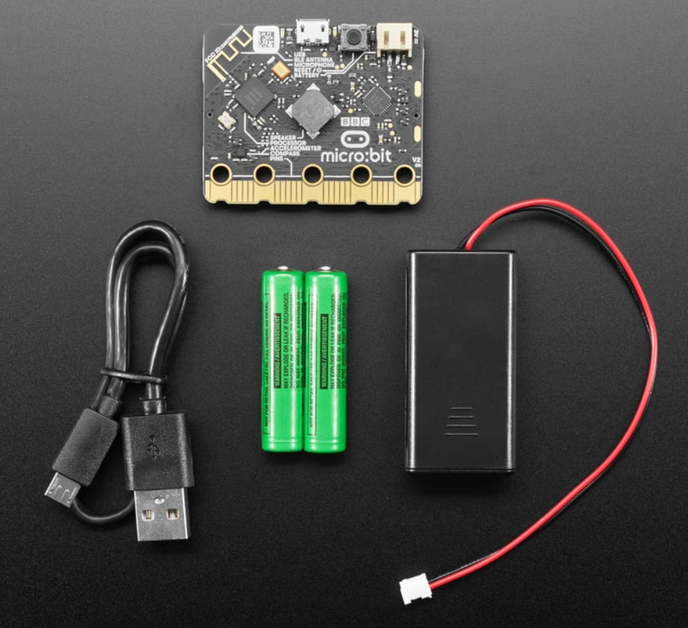
TTU Library’s Makerspace CuteBot and Micro:Bit v2 Kits
Images of our CuteBot kit and Micro:Bit v2 kit
Notes:
Microbit kits
https://www.adafruit.com/product/4833
https://www.adafruit.com/product/4834
CuteBot Kits
https://www.adafruit.com/product/4575

Slide 7
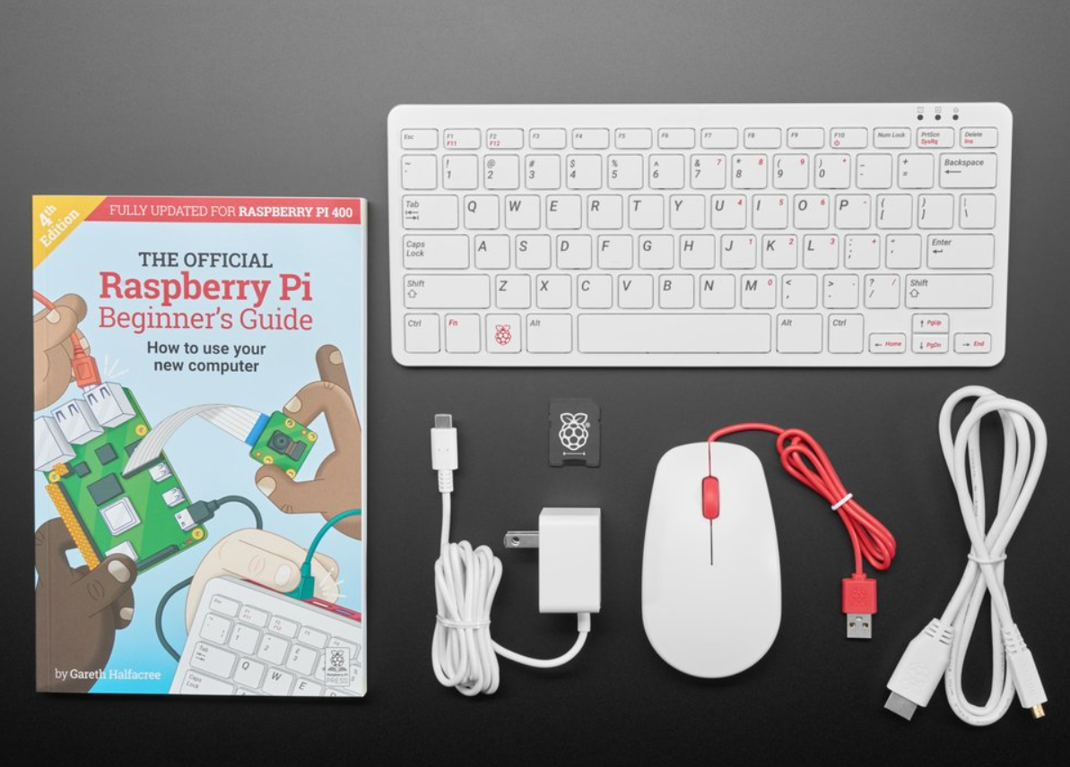
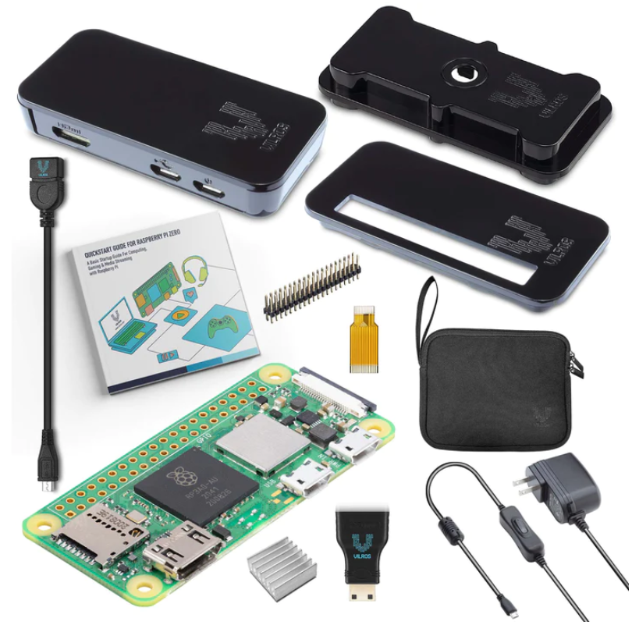
TTU Library’s Makerspace Pi-400 and Pi-ZeroW Kits
6 kits of each is available: recommend supplying your own microSD card (minimum size: 8Gb)
Notes:
https://vilros.com/collections/raspberry-pi-kits/products/vilros-raspberry-pi-zero-2-w-basic-starter-kit
https://www.adafruit.com/raspberrypi400

Slide 8
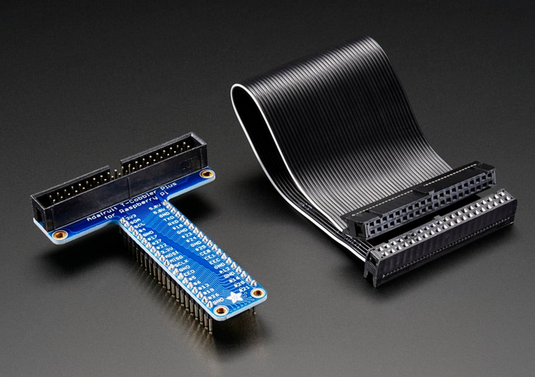
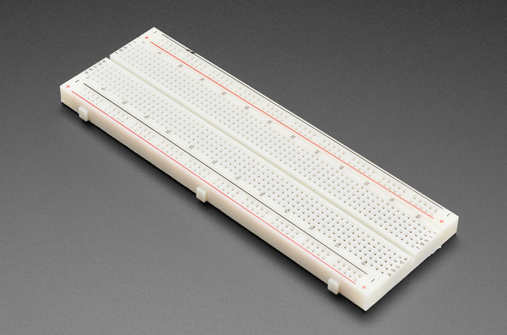
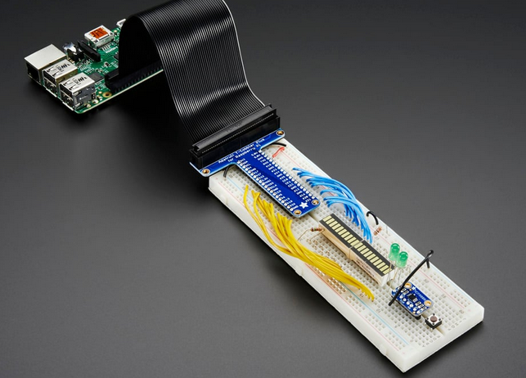
TTU Library’s Makerspace Pi – Interface Kits
6 kits of each is available, one for every Pi-400
Pi T-Cobbler Plus
GPIO Breakout - Pi A+, B+, Pi 2/3/4, Zero
Full Sized Premium Breadboard
830 Tie Points
Notes:
https://www.adafruit.com/product/2028
https://www.adafruit.com/product/239

Slide 9
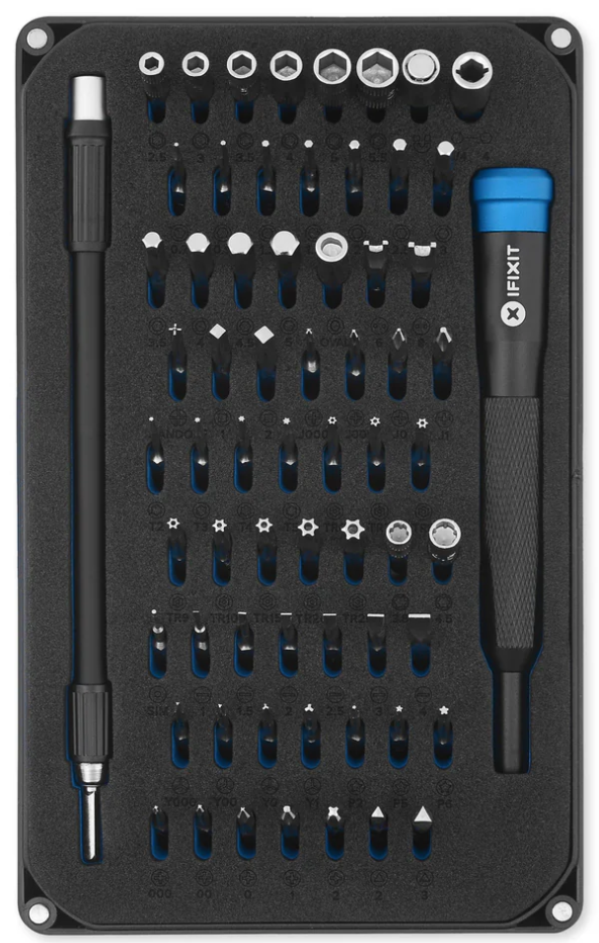
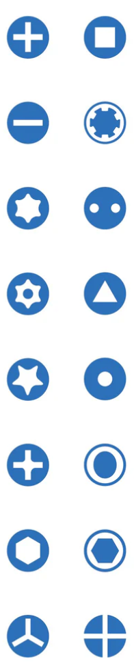
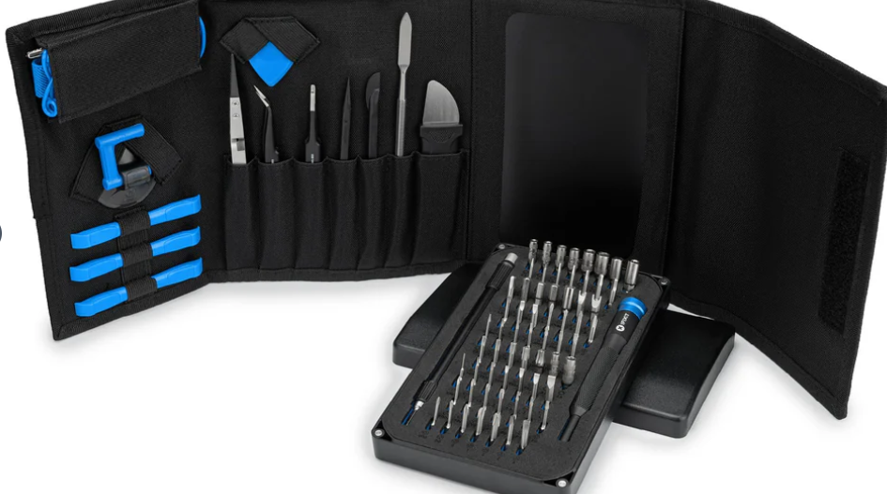
TTU Library’s Makerspace iFixit Kits
6 kits of each is available, one for every Pi-400
all kinds of screwdriver tips, 64 total
larger kit has spudgers and plastic pryers
Notes:
https://www.ifixit.com/products/mako-driver-kit-64-precision-bits
https://www.ifixit.com/products/pro-tech-toolkit

Slide 10
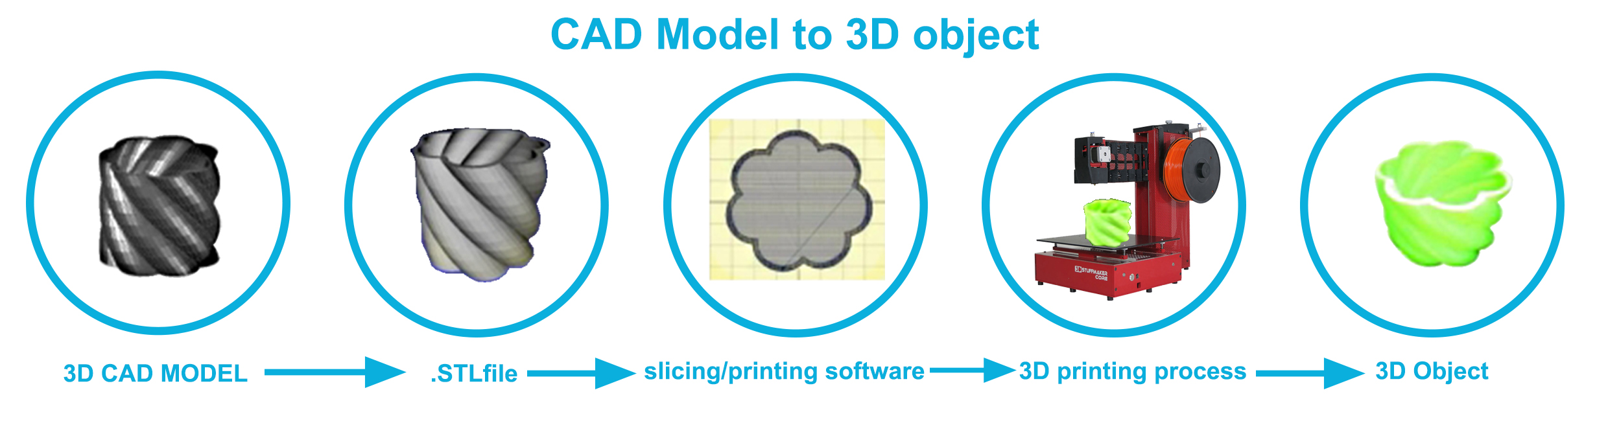
Overview
Notes:
3Dstuffmakers.com

Slide 11
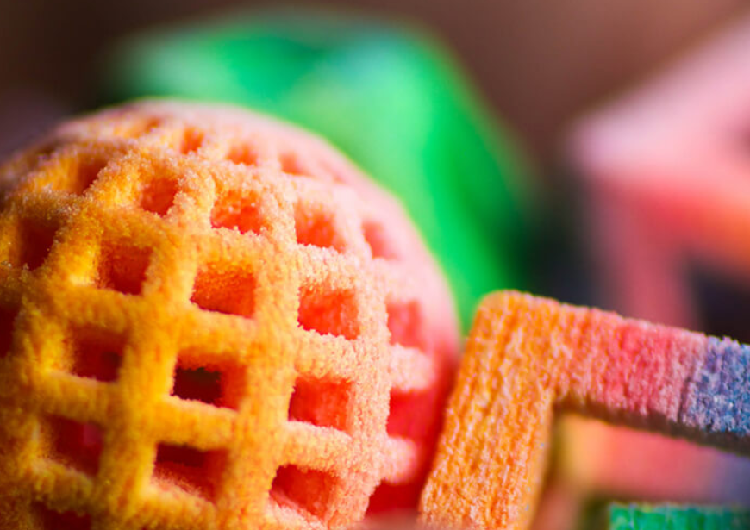
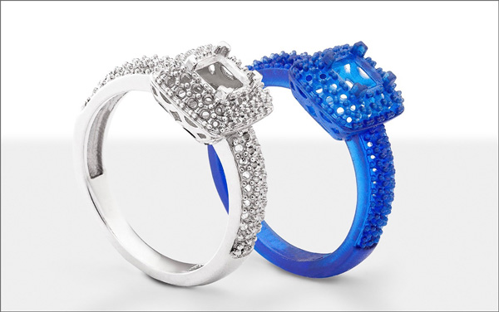
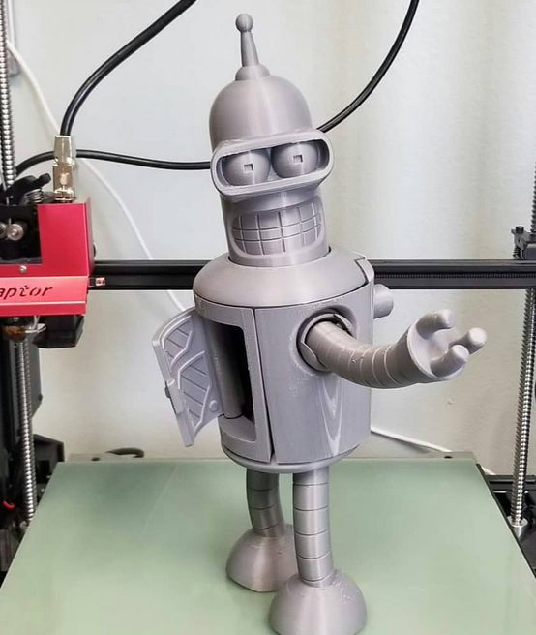
three common styles of 3D printer:
Powder –layers of thin dust built with a binder
ZCorp., powdered cornstarch/gypsum, inkjet binder
Titanium/stainless steel powder fused with high power laser/plasma beam
Resolution varies widely, but generally the roughest of these processes
Resin – Light-sensitive resin that hardens in layers as you expose it to images from an LCD, a projector or a laser beam
“Form” printers or LCD printers
Resolution high, measured in micron layer-heights
Filament – Fused-Deposition-Modeling (FDM) using a stream of material that hardens/cools that will fuse in layers
FFF - Fused Filament Fabrication
Resolution varies with the printer extrusion parameters
0.06 mm – 0.4 mm height x 0.4 mm width
Notes:
http://makemode.co/wp-content/uploads/2017/08/resin_2A.jpg
https://quillandpad.com/wp-content/uploads/2014/06/3d-Systems-Chefjet-sugar-printing-Z-corp-inkjet-powder-bed.jpg
https://www.filacube.com/collections/2-85mm-1kg-filacube-3d-printer-pla-2-filament-18-colors-3mm/products/2-85mm-1kg-silver-filacube-3d-printer-pla-2-filament-3mm

Slide 12
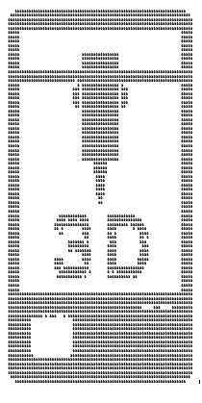
3D printing questions
flat side down
best to halve and glue
minimize support material
durability, temperature, solvents, requirements
optimize thickness
efficiency/strength
limits of the printer (min thickness 0.8mm)
orientation
direction for most strength
most precise/highest resolution
Notes:
https://www.matterhackers.com/articles/3d-printing-beginner-guides-collection
3d printing basics: https://www.youtube.com/watch?v=1nKX5Vx9DuY
Types of plastic printing filament: https://www.youtube.com/watch?v=Or1FP43zx3I

Slide 13
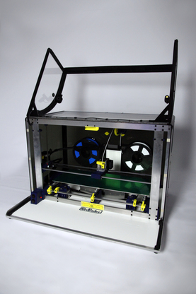
our PolyPrinters (229/508)
Layer height 0.25mm, width 0.4mm (0.4 mm nozzle)
Print volume maximums
229: 220 x 220 x 220 mm
508: 220 x 490 x 220 mm
https://polyprinter.com/
Printers use 1.75mm diameter filament
Default material: ABS (Acrylonitrile butadiene styrene – a thermoplastic polymer)
prints at 260-270C and print bed temperature of 110C
fee of $1.00 for each print bed/color used
10 cents/gram of filament used
NinjaFlex (a brand of TPU filament – thermoplastic urethane)
prints at 230-250C with print bed temperature of 60C
fee of $1.00 for each print bed/color used
30 cents/gram of filament used
For models that only fit on 508, bed fee will be $2.00

Slide 14
PolyPrinter - Additional Reference
UTA EE Labs – PolyPrinter Walkthrough
https://www.youtube.com/watch?v=ElMy8vTiJOM
PolyPrinter FAQ
https://polyprinter.com/content/UserQuestionsAndAnswers/UserQuestionsandAnswers.html
PolyPrinter Manuals/Documentation
https://polyprinter.com/downloads/
https://polyprinter.com/content/229_508%20User%20Manual.pdf
https://polyprinter.com/content/NozzleChange.pdf

Slide 15
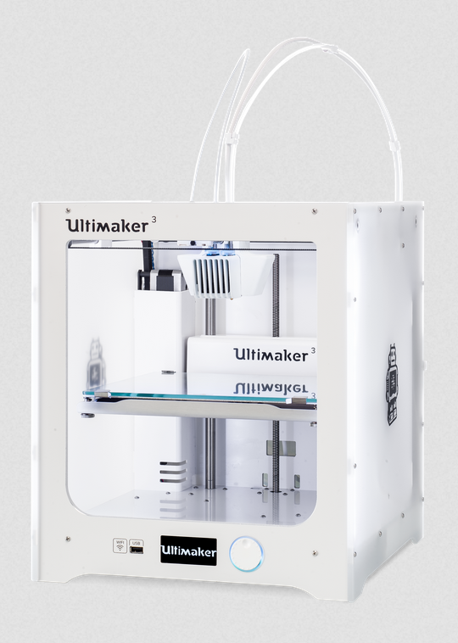
our Ultimakers 3 + S7
Layer height 0.06-0.3mm
Layer width 0.4mm
0.25mm, 0.4mm, 0.8mm nozzle options
Print volume maximums
Ultimaker 3:
230 x 190 x 200 mm
https://ultimaker.com/3d-printers/ultimaker-s3
Ultimaker S7:
330 x 240 x 300 mm (13 x 9.4 x 11.8 inches)
https://ultimaker.com/3d-printers/s-series/ultimaker-s7/
Printers use 2.85mm/3mm diameter filament
PLA/ToughPLA/Nylon/TPU/PP plastic
Fee of $1.00 for each print bed/color/extruder used
30 cents/gram of filament used
Breakaway PLA/Dissolvable PVA plastic
Fee of $1.00 for each print bed/color/extruder used
30 cents/gram of filament used
Notes:
https://www.matterhackers.com/articles/3d-printing-beginner-guides-collection

Slide 16
Samples Samples Samples
Always print the challenging portions of your project
Saves time and material
Gain specific knowledge of printer limitations
Speeds design iteration timetable
Ensures success
Rhino & Blender (formerly used 3D Builder)
Preview and repair STL files
Chop parts into pieces: “Split”
“Settle” parts: add gravity to ensure good bed adhesion during printing
Practice challenging prints from model repositories (free)
Thingiverse
Cults3D
yeggi

Slide 17
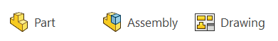
A Brief Intro to SOLIDWORKS
About advanced CAD programs

Slide 18
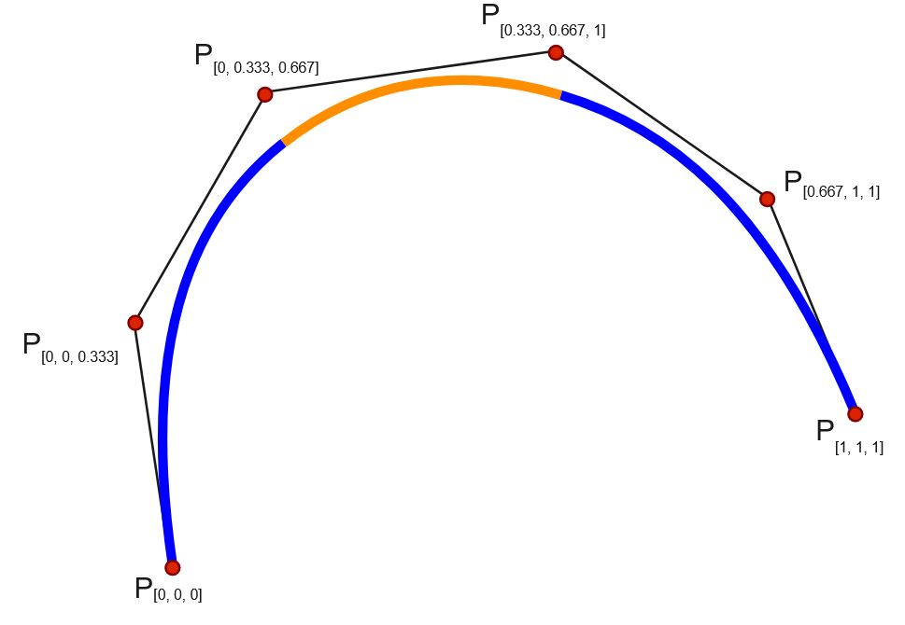
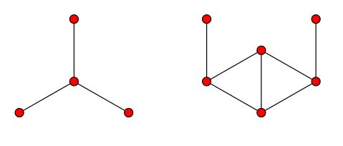
What is CAD made of:
Points
1D object, coordinates (x,y,z)
Lines
two+ points connected
Splines
parametric curves
Notes:
https://en.wikipedia.org/wiki/Spline_(mathematics)
https://en.wikipedia.org/wiki/Line_graph

Slide 19
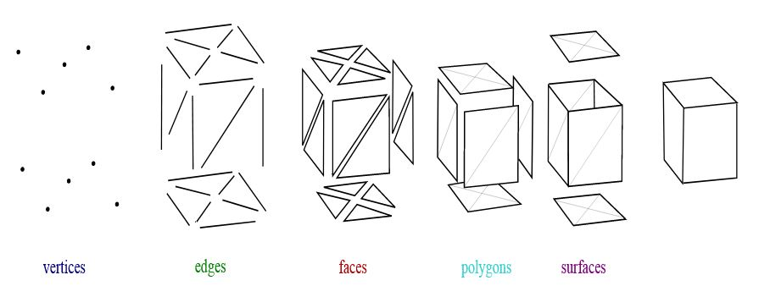
Polysurface versus Mesh:
Points
Surface
2D area defined by at least two lines
Polysurface
3D vol, two+ surfaces
Open – holes in model
Closed – “watertight”
[Polygon] Mesh
Vertices = Points
Edges = Lines
Faces ~ Surfaces
Notes:
https://en.wikipedia.org/wiki/Polygon_mesh
https://discourse.mcneel.com/t/mesh-or-surface-understanding-the-difference/75151

Slide 20
getting started - filetypes
Most common file formats you might deal with are:
.IPT, .IAM
Part file (.ipt) – each object you build
Assembly file (.iam) – file for importing parts and deciding their relationships
Autodesk-specific file types
.STL (Surface Tessellation Language file)
a system of triangles, originally for stereolithography
The standard used by slicer programs for 3D printing
.DWG, .DWF, .3DM
Editable CAD files – more general information about 3d objects/drawings
Used by Autodesk Suite and several other programs
https://fileinfo.com/filetypes/cad
Notes:
STL file format is the PDF for 3D files, not always easily edited but easily read on multiple platforms and programs

Slide 21
getting started: SOLIDWORKS
http://www.solidworks.com/sw/support/downloads.htm
On-campus Computers (already installed, eraider login)
Library’s 2nd floor: 3D Animation Lab room 205 (only on 2 computers)
Engineering Computer Labs
@Home - Recommended hardware
Internet connection (only required for installation)
https://www.solidworks.com/support/system-requirements
Two-button mouse with a scroll that can click
A 64-bit Win11 system with a non-integrated graphics card is ideal
Mac users require a virtual machine which can significantly change the user experience
Educational Install
https://www.solidworks.com/community/3dexperience-login
https://my.solidworks.com/try-solidworks

Slide 22
sketches - Body / Part - Assembly
Sketches
Best place to start building/modifying your model
Drawing aligned normal (perpendicular) to a particular plane X, Y, or Z
Body
Extruded sketch
Model object and all of the modifications (chamfer/fillet/extrusion)
Part
A file for each modeling object
Assembly
Separate file for importing/arranging Part files
Notes:
Sketches:
https://knowledge.autodesk.com/support/inventor-products/learn-explore/caas/CloudHelp/cloudhelp/2015/ENU/Inventor-Help/files/GUID-805F6BA4-7D57-484B-A598-8B8B3E6EDED1-htm.html
Body:
https://knowledge.autodesk.com/support/inventor-products/learn-explore/caas/CloudHelp/cloudhelp/2014/ENU/Inventor/files/GUID-8E641EB9-90E7-40AB-ACC6-222CB613E712-htm.html
Part:
https://knowledge.autodesk.com/support/inventor/learn-explore/caas/CloudHelp/cloudhelp/2020/ENU/Inventor-EssentialVideo/files/GUID-262ECCCB-E5C9-495D-A7F2-2DE6A0836361-htm.html
Assembly:
https://knowledge.autodesk.com/support/inventor/learn-explore/caas/CloudHelp/cloudhelp/2020/ENU/Inventor-Help/files/GUID-5A8DD595-7BD4-4B15-A48B-32AC0245FBB0-htm.html

Slide 23
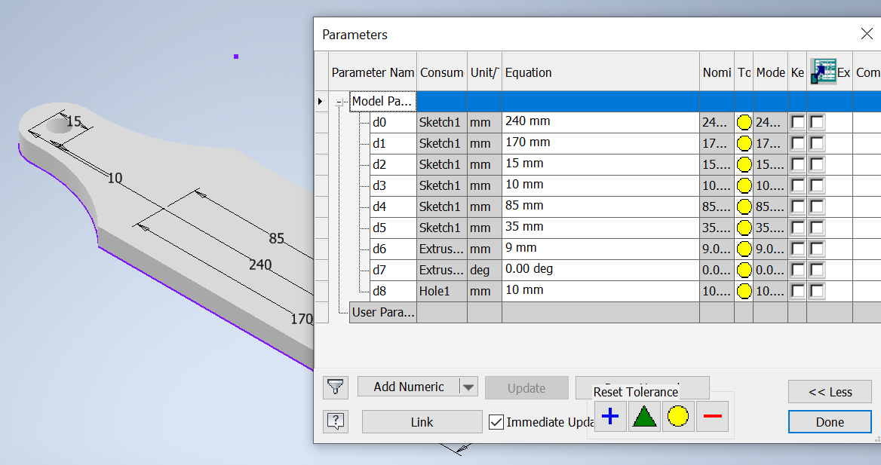
Parametric Modeling – User Parameters
Notes:
Address strengths, weaknesses of applications

Slide 24
new features/tutorials
new for 2025
https://www.solidworks.com/product/whats-new#brick--7869--default--en
plier tutorial
https://www.youtube.com/watch?v=2mN7m2G5kCI&list=PLiKqXuECiKNK9bUR2xWG4Ox_AVK-jBbt9
Solidworks Youtube Channel
https://www.youtube.com/@solidworks/playlists

Slide 25
onward: assistance is available
The Staff and Student Assistants in the Makerspace are here to help!
There are O’Reilly video and text tutorials available to help learn the more advanced software (Solidworks, Inventor, Rhino, Grasshopper, etc.) through Library Databases:
Search for “oreilly” @
http://texastech-ml.hosted.exlibrisgroup.com/V/?func=find-db-1

Slide 26
onward: 3D printing near me
On TTU Campus
TTU Library Makerspace – make@ttu.edu, Library 210, https://www.depts.ttu.edu/library/make/index.php
ATLC - Library basement, https://www.depts.ttu.edu/itts/services/3dprint/faqs.php
Architecture - https://www.depts.ttu.edu/architecture/
3D Art Annex - http://www.depts.ttu.edu/art/Programs/graduate/studio_art/sculpture/index.php
Mechanical/Civil Engineering & IMSE
Ask your department – there are 3D printers hidden all over campus
Off-Campus
ULABS (Ubiquitous Makerspace) - http://www.ulabstx.org/
Science Spectrum - https://www.sciencespectrum.org/fab-lab/
Online
Shapeways - https://www.shapeways.com/
UPS - https://www.theupsstore.com/print/3d-printing
iMaterialise - https://i.materialise.com/en
MyMiniFactory - https://www.myminifactory.com/

Slide 27



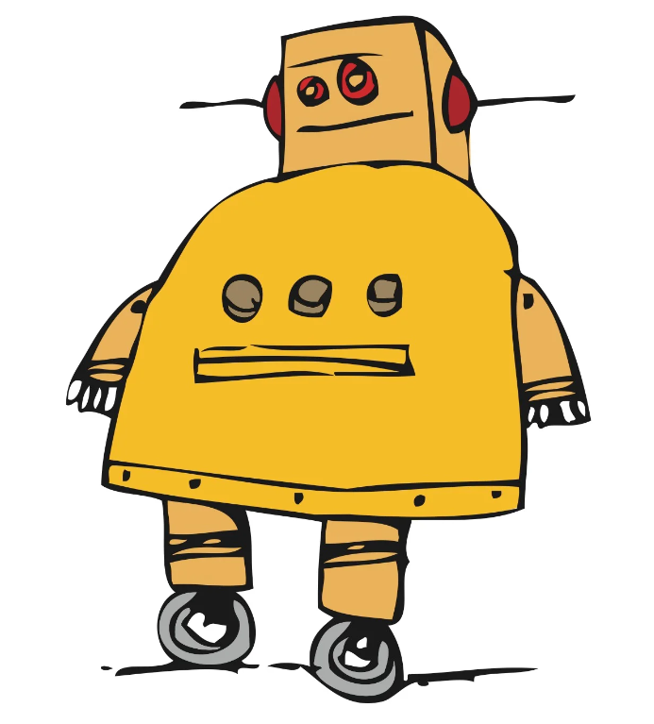

projects galore
project-sharing websites (some require membership)
https://learn.adafruit.com/
https://www.hackster.io/
https://www.instructables.com/
https://hackaday.io/
https://make.co/
Support/Forums/Discord
Official forums/support
https://my.solidworks.com/forums
https://my.solidworks.com/support
Unofficial discord
https://discord.com/invite/MUYheHd
https://discord.gg/invite/solidworks-590336164549099520
Adafruit
http://adafru.it/discord

Slide 28
thank you!
please share your projects and progress!
“Make with Solidworks” with Instructor Sean Scully
review this workshop here:
https://ttu.libwizard.com/f/workshop-eval-24-25_emerging_tech
Lead Administrator - sean.scully@ttu.edu
Makerspace - make@ttu.edu
Director/Librarian - ryan.cassidy@ttu.edu
Assoc. Librarian – jake.syma@ttu.edu
Workshop Guides- https://guides.library.ttu.edu/make
Notes:
https://ttu.libwizard.com/f/workshop-eval-24-25_emerging_tech
Thank you for your attention!

